Slide 1


Food Trend Analysis: Customer Behavior and Market Insights
Transforming raw F&B data into actionable business intelligence using Microsoft Power BI
Presented by: Meher Raju
Submitted to: Nithyasri S J

Slide 2
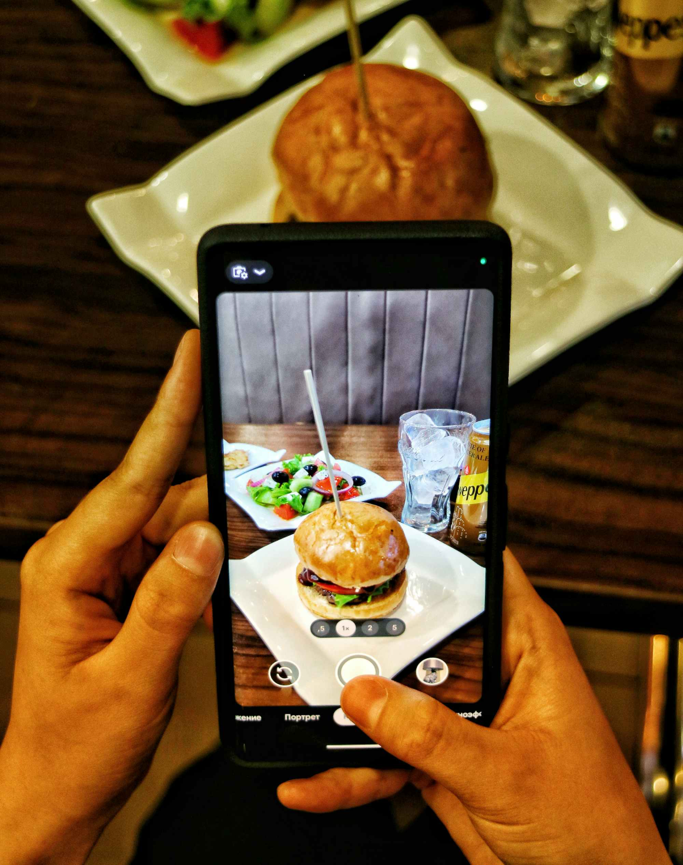

The Challenge in Today's F&B Landscape
Industry Context
The food and beverage industry is experiencing rapid transformation driven by online delivery platforms and the exponential growth of customer data. Businesses now operate in a highly competitive, data-rich environment.
The Core Problem
Many F&B businesses struggle to keep pace with evolving customer demands due to a critical lack of real-time insights and actionable intelligence from their data.
Our Solution: A comprehensive Power BI dashboard that consolidates, visualizes, and interprets customer behavior patterns to drive strategic decision-making.

Slide 3





Project Objectives
Customer Demographics
Analyze customer profiles, preferences, and purchasing behaviors across different demographic segments
Product & Category Trends
Identify top-performing items and emerging category trends to optimize menu offerings
Platform Performance
Evaluate delivery platform effectiveness and digital payment adoption patterns
Future Trend Forecasting
Predict upcoming food trends and seasonal patterns to stay ahead of market shifts

Slide 4

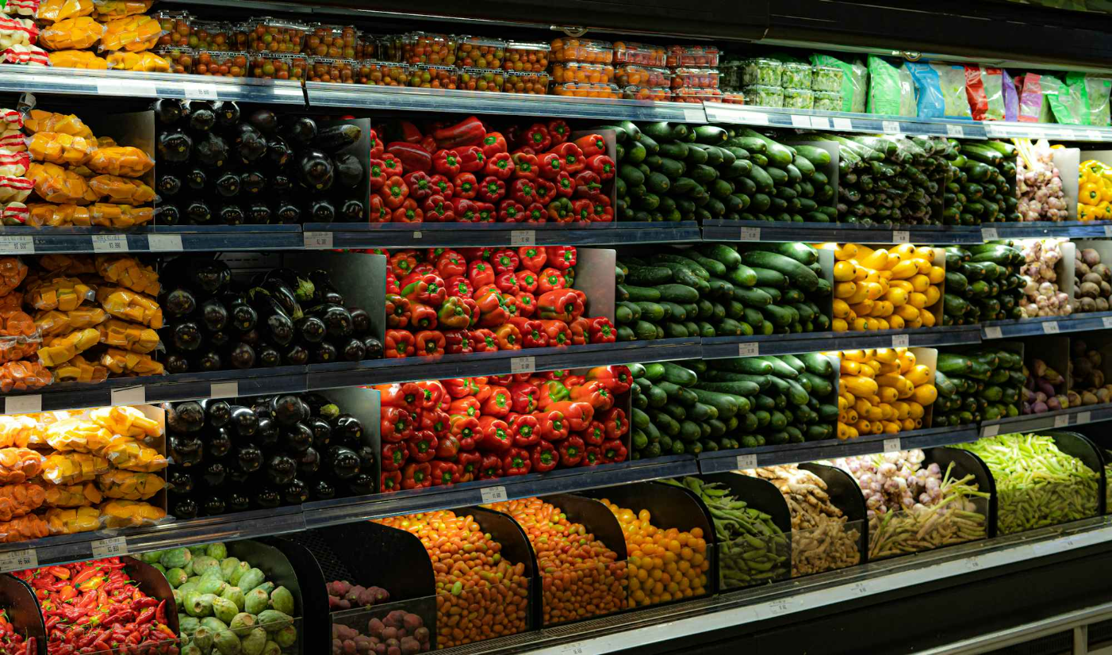


Data Foundation & Technology Stack
Dataset Overview
Our analysis leverages a comprehensive synthetic dataset designed to mirror real-world F&B operations, containing approximately 4,500–5,000 customer orders with 20 distinct features covering demographics, preferences, order details, and satisfaction metrics.
Microsoft Power BI
Primary platform for dashboard creation and interactive data visualization
Power Query
Data transformation and cleansing to ensure accuracy and consistency
DAX Language
Advanced calculations and custom measures for deeper business insights

Slide 5







Interactive Dashboard Architecture
The Power BI dashboard serves as a centralized intelligence hub, featuring six specialized analytical pages that enable stakeholders to explore data from multiple business perspectives.
Sales Overview
Customer Insights
Product Insights
Regional Insights
Seasonal Trends
Future Insights

Slide 6
Customer Demographics & Behavior Patterns
Key Demographic Findings
Female Preference
Spending Behavior
Female customers show slightly higher engagement, particularly for desserts and beverages
Customer income level demonstrates a strong positive correlation with average order value, with higher-income segments spending up to 40% more per transaction.
The 18–30 age group drives nearly half of all orders, representing the core customer base

Slide 7

Product Performance & Menu Insights
Category Leaders
High Satisfaction Performers
Top-Selling Menu Items
Fast food and beverages consistently dominate both revenue generation and order frequency, establishing themselves as the backbone of F&B operations.
Burgers, brownies, and biryanis emerge as the "Triple B" champions, driving consistent sales across all regions and demographics.
Desserts receive exceptional customer satisfaction scores, indicating strong product-market fit and opportunities for expansion.

Slide 8
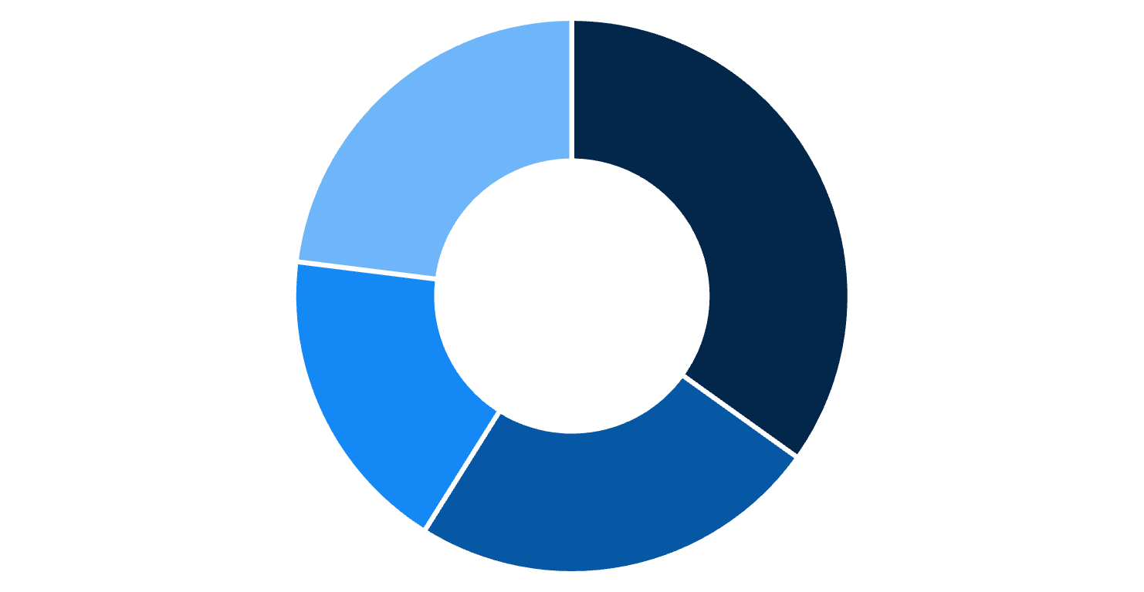
Regional & Platform Distribution
Geographic Performance
Delivery Platform Landscape
40%
Zomato
35%
Swiggy
25%
North
South
East
West
The North region leads with approximately 35% of total revenue, presenting both a strength to leverage and an opportunity to replicate success in other markets.
Other Platforms
Zomato dominates the platform ecosystem, while digital wallet and UPI payments show strong adoption in urban markets, reflecting the shift toward cashless transactions.

Slide 9

Seasonal Patterns & Time-Based Trends
1
Peak Ordering Windows
Weekends and evening hours (6 PM–9 PM) drive the highest order volumes, with Friday and Saturday showing 60% more orders than weekdays
2
Summer Preferences
Desserts and beverages experience significant demand increases during warmer months as customers seek refreshing options
3
July Peak Season
July emerges as the highest-performing month, likely driven by vacation periods and seasonal celebrations
4
November Downturn
November shows the lowest order volumes, presenting an opportunity for targeted promotional campaigns

Slide 10




Strategic Recommendations
Seasonal Campaign Optimization
Platform Partnership Enhancement
Intensify promotions for fast food and beverages during peak summer months and high-traffic periods to maximize revenue potential
Strengthen strategic partnerships with Swiggy in high-performing regions while exploring growth opportunities with Zomato in underserforming markets
Regional Market Expansion
Digital Payment Incentives
Launch targeted marketing campaigns in underperforming regions, leveraging successful tactics from the North region playbook
Enhance digital wallet and UPI offers to accelerate cashless adoption and improve transaction efficiency across all customer segments
This comprehensive Power BI dashboard successfully translates complex F&B data into clear, actionable intelligence, empowering stakeholders to proactively shape market trends through optimized menu planning, targeted marketing, and efficient operations management.

Slide 11
Thank You
Thank you for your attention and engagement today. We hope the insights into food trend analysis and the capabilities of the Power BI dashboard have been valuable.
We look forward to leveraging these insights together for future success.

